Slide 1
EMTH403
Mathematical Foundation for Computer Science

Slide 2
Lecture Outcomes
understand what is graph coloring.
understand what is a 4-Color Map Theorem.
understand what is a chromatic number

Slide 3
Coloring Graphs
Definition: A graph has been colored if a color has been assigned to each vertex in such a way that adjacent vertices have different colors.
Definition: The chromatic number of a graph is the smallest number of colors with which it can be colored.
In the example above, the chromatic number is 4.

Slide 4
Coloring Graphs - Example
What is the chromatic number of the graph shown below?
The chromatic number must be at least 3 since a, b, and c must be assigned different colors. So Let’s try 3 colors first. 3 colors work, so the chromatic number of this graph is 3.
b e
a d g
c f

Slide 5
Real world problem
Assigning of a GSM frequencies in INDIA such that no two states frequencies could not be overlapped.
How can we assign the frequencies such that least number of frequencies can be used.
This is applicable to all the countries.

Slide 6
Coloring Graphs
When a map is colored, two regions with a common border are customarily assigned different colors.
We want to use the smallest number of colors instead of just assigning every region its own color.

Slide 7
Coloring Graphs
4-Color Map Theorem.
It can be shown that any two-dimensional map can be painted using four colors in such a way that adjacent regions (meaning those which sharing a common boundary segment, and not just a point) are different colors.

Slide 8
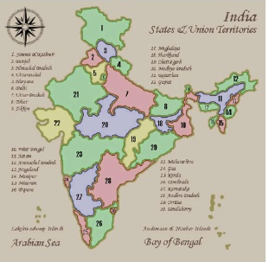
Coloring Graphs
Solution to Problem

Slide 9
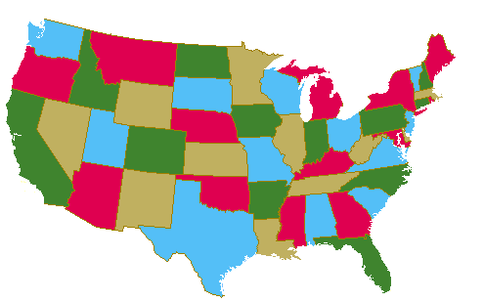
Coloring Graphs
Four colors are sufficient to color a map of the contiguous United States.
Source of map:
http://www.math.gatech.edu/~thomas/FC/fourcolor.html

Slide 10
Coloring Graphs
Definition: A graph is planar if it can be drawn in a plane without edge-crossings.
The four-color theorem: For every planar graph, the chromatic number is ≤ 4.
Was posed as a conjecture in the 1850s. Finally proved in 1976 (Appel and Haken) by the aid of computers.

Slide 11
Coloring Graphs
The standard approach to coloring a map is to use a single color for a state and never use the same color for two states.
Two states whose common border is just one point can be colored, if we so choose, with the same color.

Slide 12

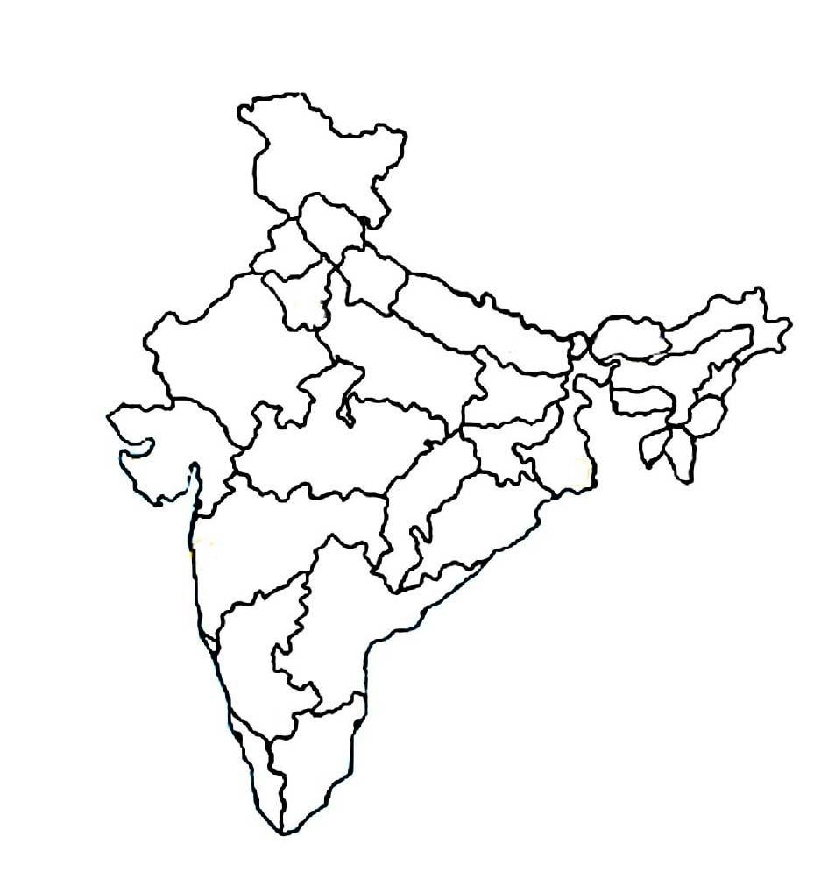
Coloring Graphs

Slide 13
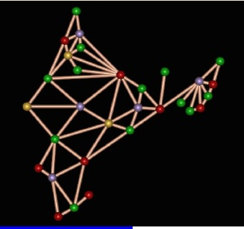
Coloring Graphs
GSM networks used to operate in only four different frequency ranges.
The reason why only four different frequencies because any country can colored with four different colors.

Slide 14
Coloring Graphs
Graph Coloring Problem:
Given a graph, color all the vertices so that
two adjacent vertices get different colors.
Objective: use minimum number of colors.
3-colourable

Slide 15
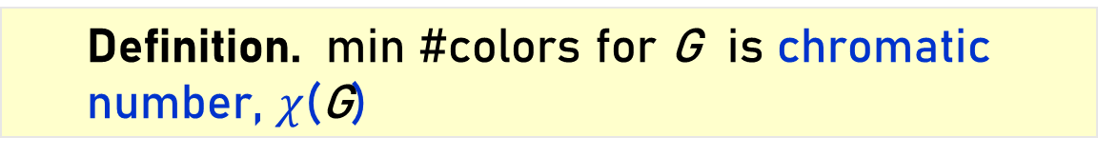
Coloring Graphs
  Definition. min #colors for G is chromatic number, $χ$(G)
What graphs have chromatic number one?
when there are no edges…
What graphs have chromatic number 2?
What graphs have chromatic number larger than 2?
A path? A cycle? A triangle?

Slide 16
Coloring Graphs - Simple Cycles

Slide 17
Coloring Graphs - Complete Graphs

Slide 18
Coloring Graphs - Wheels

